Slide 1
Camera Transitions
By: Ángel González

Slide 2
What is a Camera Transition?
“Technique used in the post-production process of film editing and video editing by which scenes or shots are combined. Most commonly this is through a normal cut to the next shot.”
Wikipedia
Notes:
The selective use of various transitions to convey a tone or a mood, suggest the passage of time…
In short, for aesthetic purposes.

Slide 3
Basic Transitions

Slide 4

Cut
Notes:
Instantly connects one shot to another. These shots normally happen at the same time. No parallel in videogames as it would go against the very reason they are implemented.

Slide 5

Fade In & Fade Out
Notes:
The scene gradually turns to one colour, normally black, and comes back.
Used to convey completion, the passage of a period of time and ascension (Fade In/Out to White). The most common transition after white.

Slide 6

Wipe
Notes:
One shot replaces another, normally by traveling from one side of the screen to the other. Can also travel from anywhere on the screen.
In VG normally it’s a black rectangle crossing the screen.

Slide 7

Dissolve
Notes:
Like the wipe, one shot replaces another, but this time, instead of gradually turning to a colour, the scene turns to another. Not that common nowadays.

Slide 8

Zoom
Notes:
The zoom is incresaed in one scene and is decreased in the next one. Wants to convey a frenetic pace or emphasize on someone or something on the screen.

Slide 9
Why apply camera transitions to video games?
Notes:
If transitions are used exclusively for aesthetic purposes in the Film Industry,
why should we apply them to our videogames?

Slide 10
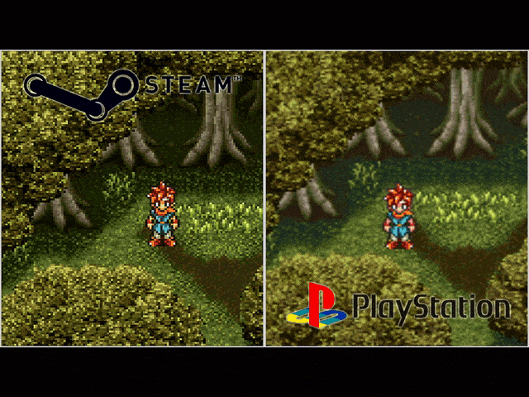

Slide 11
The reasoning behind camera transitions
We need time to load/unload a scene.
This load/unload time will freeze our game.
Implemented to hide the change process and the “freeze” time.

Slide 12
Other uses for Video Game Transitions
Move forward or backward in time.
To spice up the narrative or the cutscenes.
A E S T H E T I C S
Notes:
Basically videogames have come far enough to be able to afford using
transitions for non-utilitarian purposes.

Slide 13
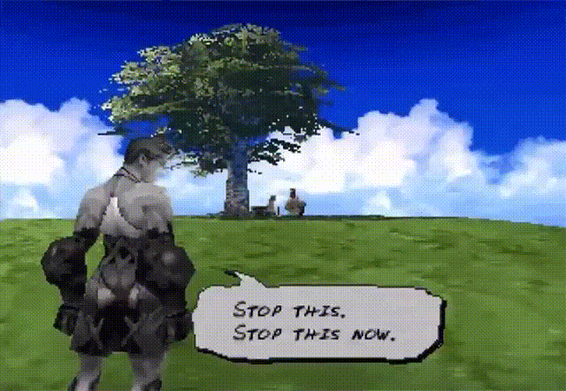

Slide 14
Video Game Transition Techniques

Slide 15
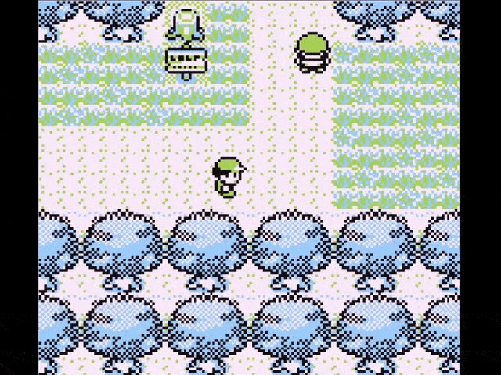
Manipulating geometrical forms
Just “moving” geometrical forms around.
Can have many shapes but are limited behaviour wise.
Really simple code wise.

Slide 16
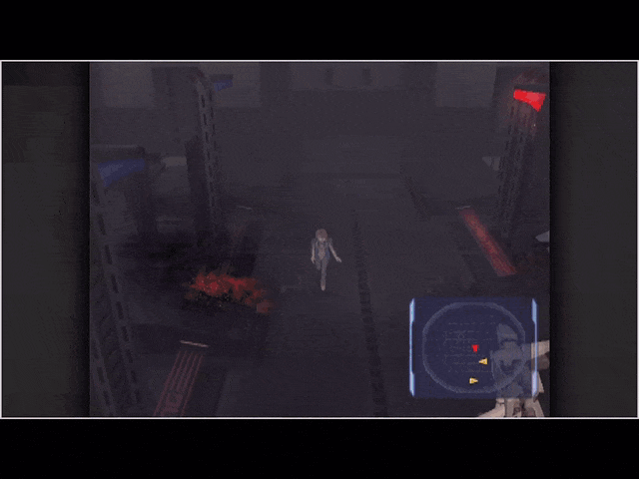
Manipulating the scene texture
All the textures are blended together and manipulated.
Really flexible.
Code wise its quite complex to make transitions like the one in the example.

Slide 17
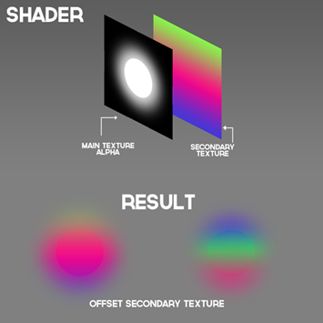
Shaders
Chunks of code that are executed in the GPU
They modify the way an image is rendered.
Using shaders to make transitions is a widespread practice due to the possibilities they bring.

Slide 18
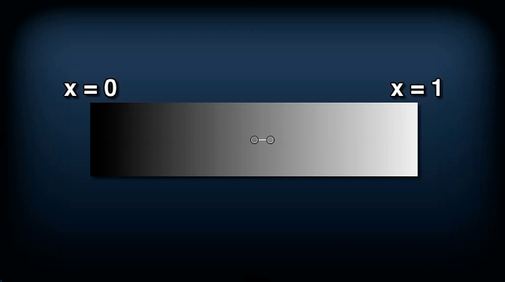

Slide 19
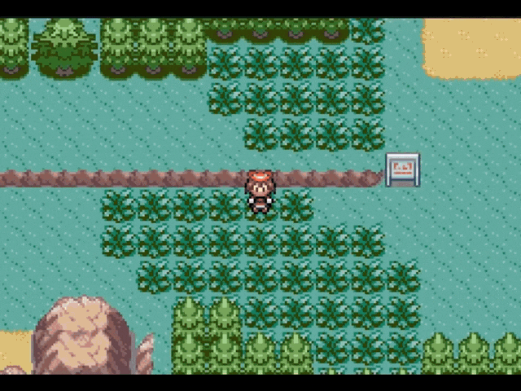


Slide 20
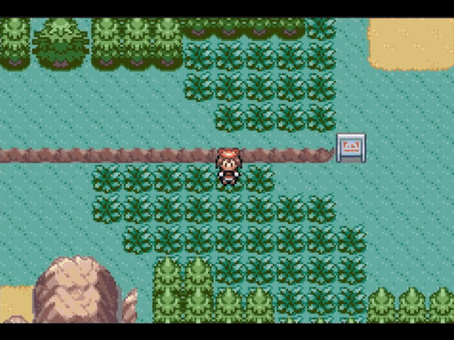


Slide 21
If you want to know more about using shaders to create transitions, check the video linked below.
It will make for a great starting point.
Shaders Case Study - Pokémon Battle Transitions

Slide 22
Video Game Transition Examples

Slide 23
Disclaimer:
The majority of the transitions that will be set as examples come from Pokemon games and games with battle transitions.

Slide 24
Common Transitions

Slide 25
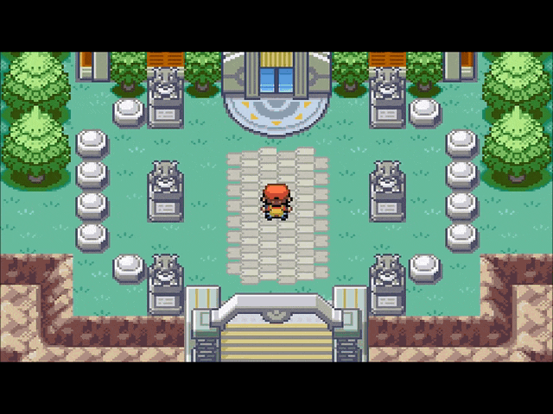
Fade To Black

Slide 26

Fancy Fade To Black

Slide 27
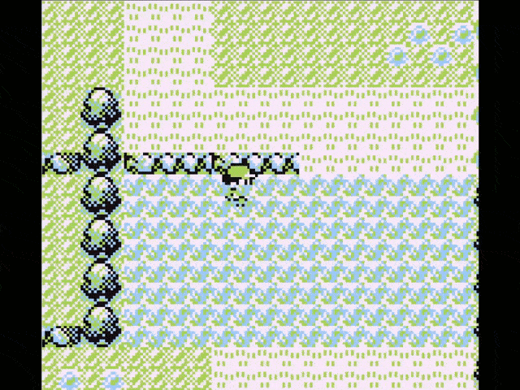
Wipe

Slide 28
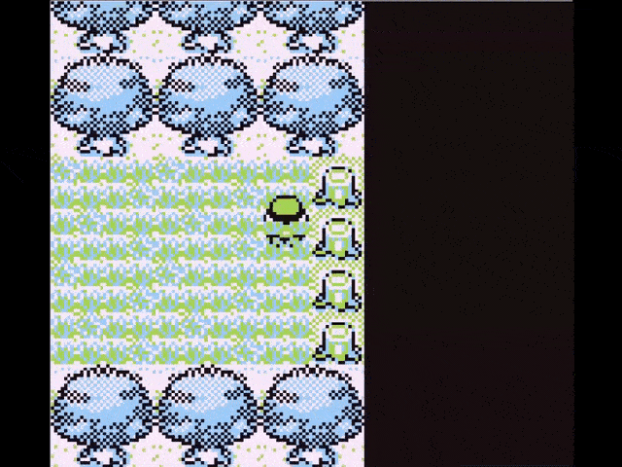
Horizontal & Vertical Alternating Bars

Slide 29
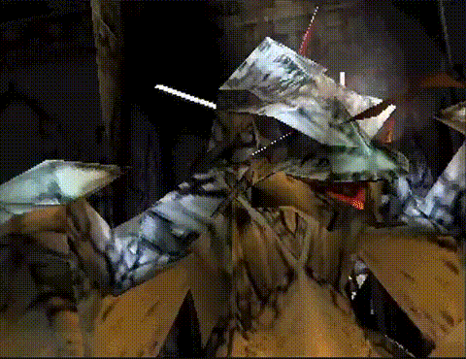
Camera Translation

Slide 30
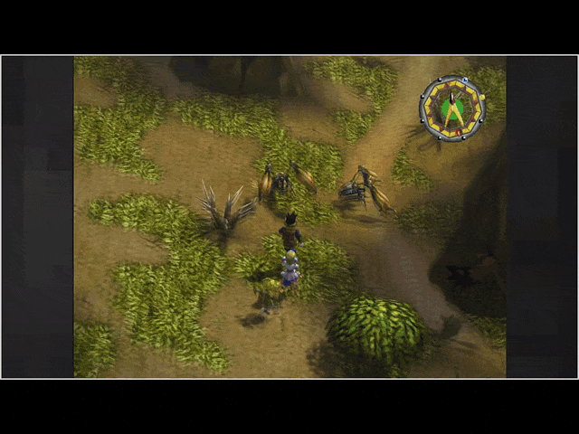
Composition of basics

Slide 31
Advanced Transitions

Slide 32
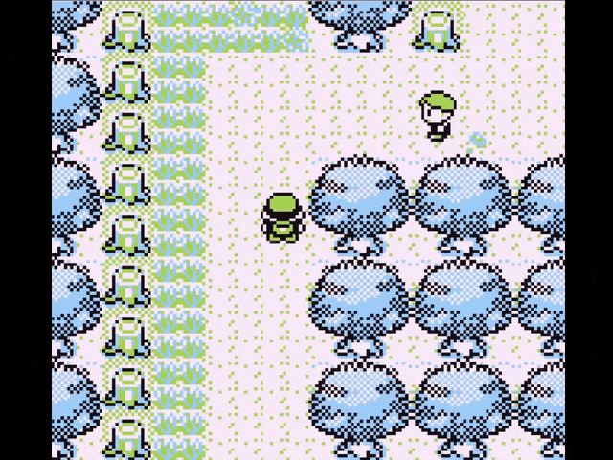
Sliding Quarters

Slide 33
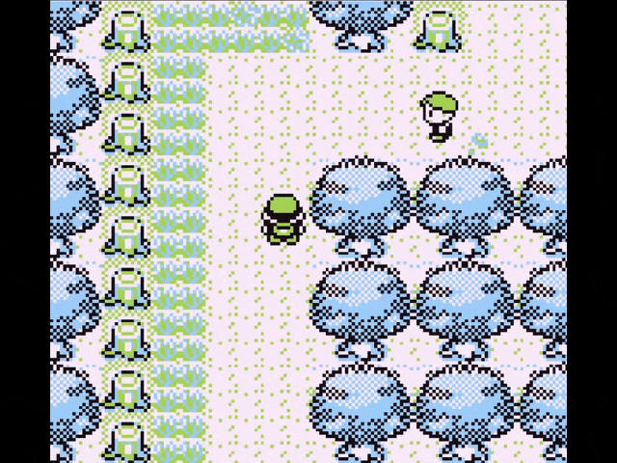
Texture re-scaling

Slide 34
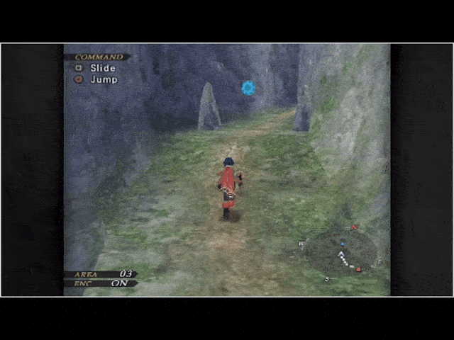
Texture manipulation (Flakes / Scales)

Slide 35
Texture manipulation (Blender effect)

Slide 36
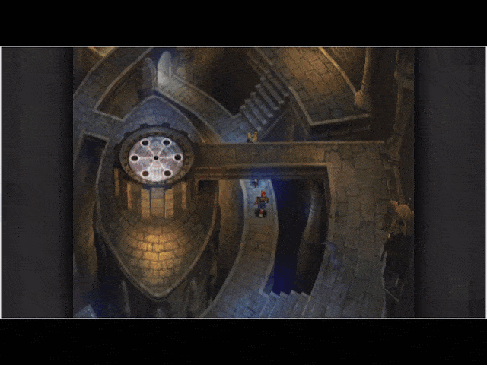
Composition of advanced

Slide 37
Themed Transitions

Slide 38

Pokemon: Battle against Gym Leader Brock

Slide 39
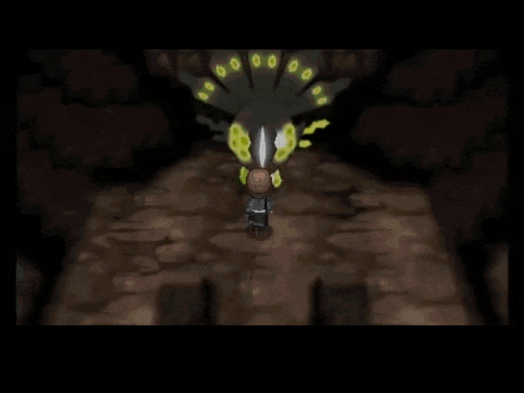
Pokemon: Battle against Zygarde

Slide 40
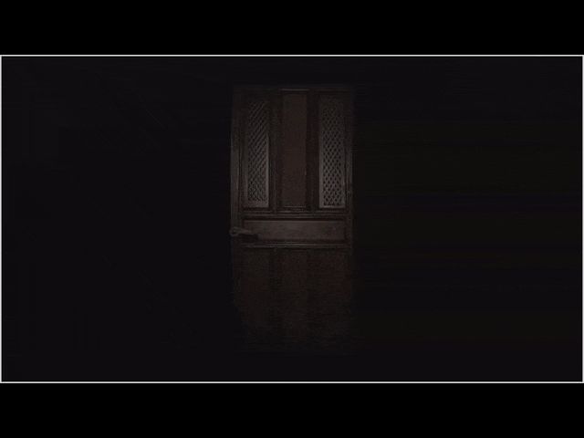
Resident Evil: Door Transition

Slide 41
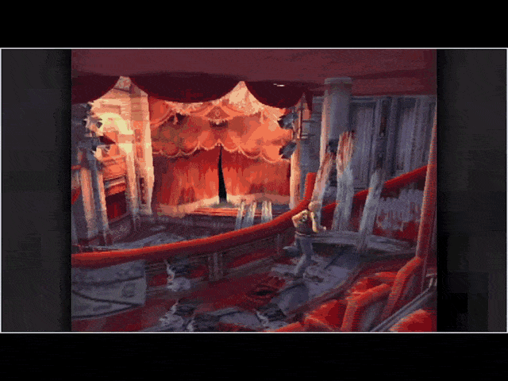
Multiple games: Mirror Break Effect

Slide 42
Code Implementation

Slide 43
System Implementation
There are 4 core elements in this system:
The Scene Manager: Creates/Updates/Changes the current_scene.
The Scene Class: Base class of all scenes.
The Transition Manager: Creates/Updates/Destroys the active_transition.
The Transition Class: Applies the transition effect and calls the Scene Manager method SwitchScene() halfway through the transition.

Slide 44
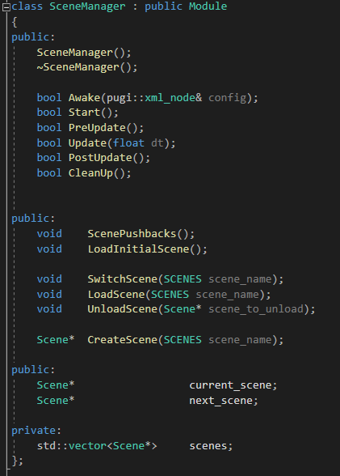
Scene Manager

Slide 45
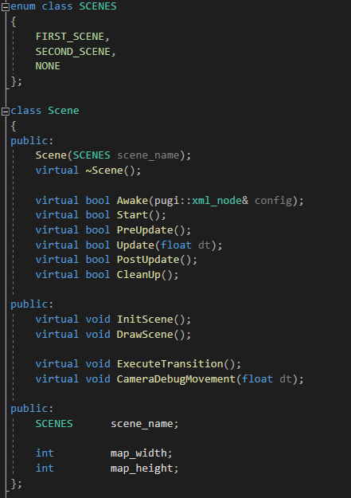
Scene Class

Slide 46
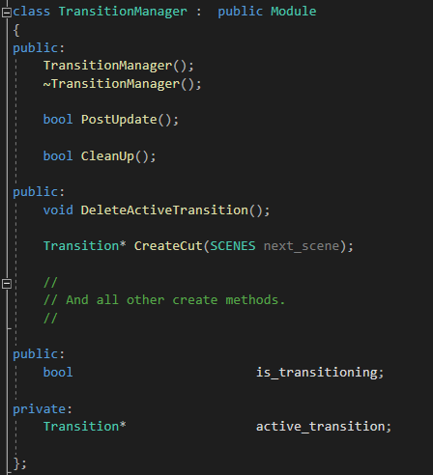
Transition Manager

Slide 47
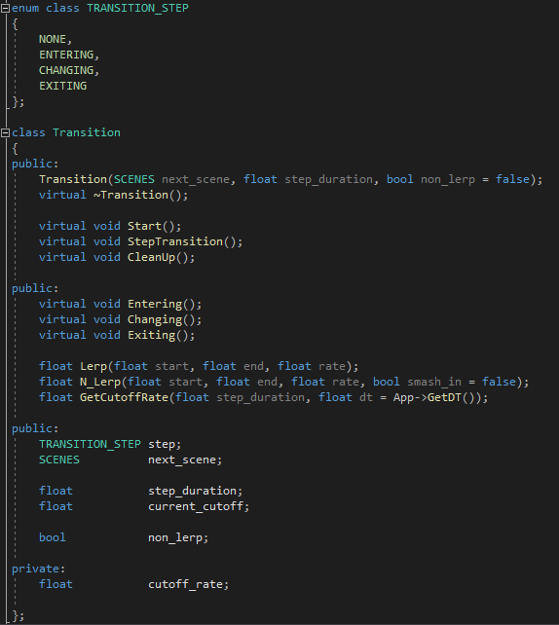
Transition Class

Slide 48
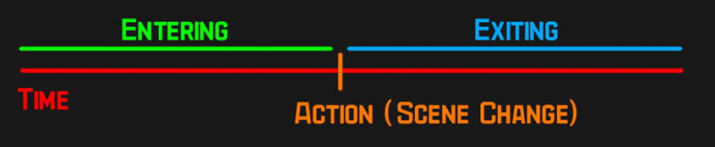
Transition Structure
There are 3 steps in the transition structure:
Entering: Step before switching scenes. Will start the transition.
Changing: Step and frame at which the scene switch happens.
Exiting: Step after scene switch. Will end and delete the transition.

Slide 49
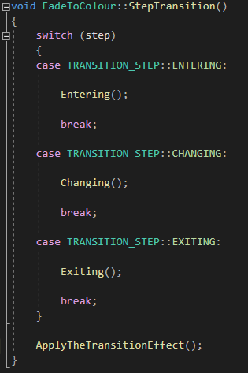
Transition Structure

Slide 50
The math behind the transitions

Slide 51
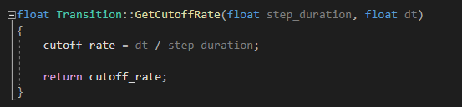
Cutoff Rate & Related Variables
cutoff_rate is a constant value that will range from 0 to 1.
current_cutoff will accumulate or subtract the cutoff_rate each loop.
The transition step will change when the total value is either 0 or 1.

Slide 52
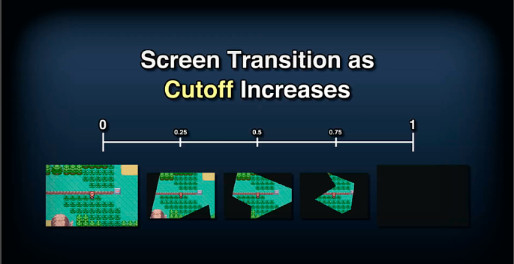
Relation Cutoff / Transition

Slide 53
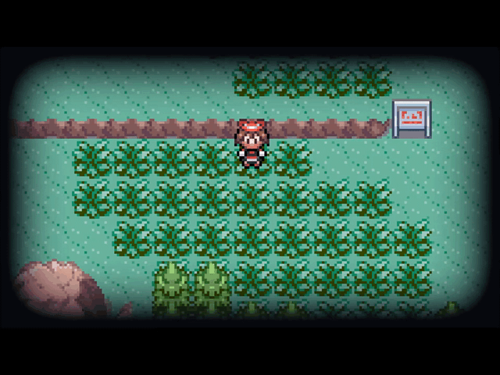
Cutoff Example: Wipe

Slide 54
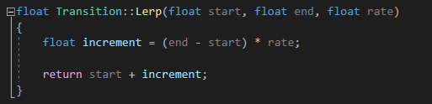
Lerp()
Will linearly interpolate two given values.
Rate goes from 0.0f (0 %) to 1.0f (100 %) advancement per frame.
If Lerp(0.0f, 10.0f, 1.0f), then the advancement per frame will be of 10.0f.

Slide 55
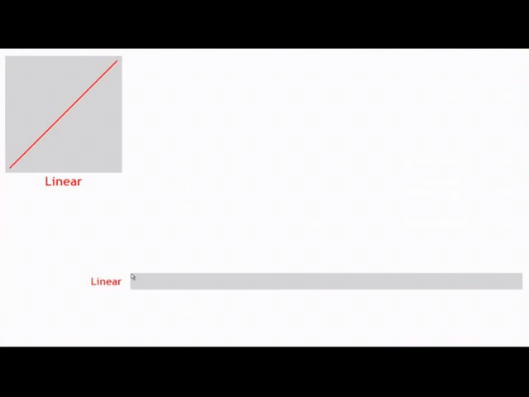
Graphical Representation of Lerp()

Slide 56
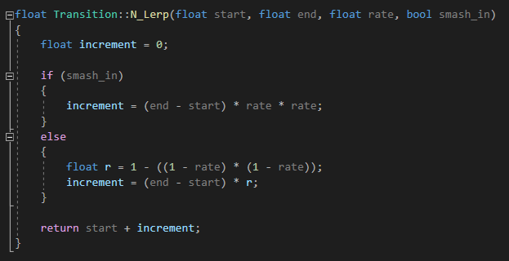
N_Lerp()

Slide 57
Ease In and Ease Out N_Lerp()
Will non-linearly interpolate two given values.
That aside these methods works the same as Lerp().
The Ease In N_Lerp() will start slow end fast. (Ease In, Smash Out)
The Ease Out N_Lerp() will start fast end slow. (Smash In, Ease Out)

Slide 58
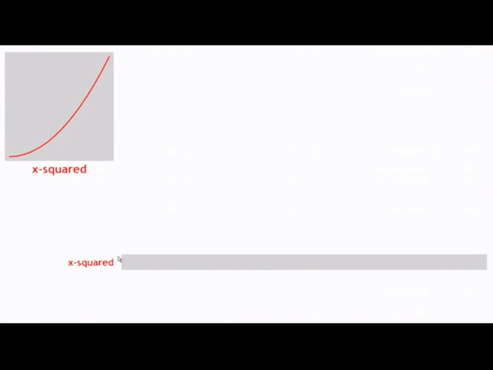
Graphical Representation of Ease In N_Lerp()
Starts Slow
Ends Fast

Slide 59
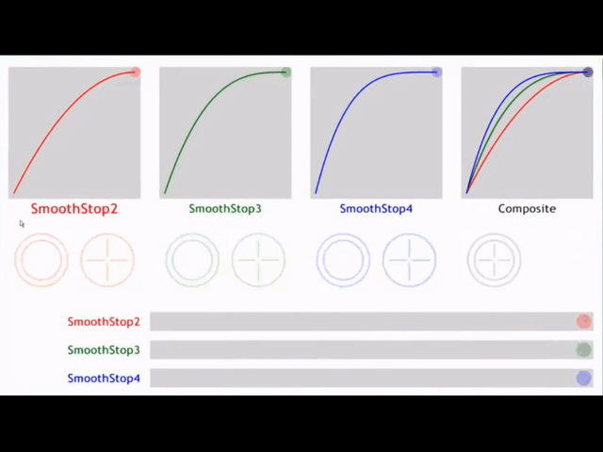
Graphical Representation of Ease Out N_Lerp()
Starts Fast
Ends Slow

Slide 60
If you want to know more about interpolation methods your games check the video linked below.
Math for Game Programmers: Fast and Funky 1D Nonlinear Transformations

Slide 61
Let’s Make Some Transitions!

Slide 62
Disclaimer:
The intended result of the TODOs can be checked out at
exercises/solution/Game/solution.exe

Slide 63
TODO 0
Check the methods and variables of each of the core elements.
Each important method has been commented, so it will be easy :)
Make sure you understand everything.

Slide 64
TODO 1
Check SwitchScene() & DeleteActiveTransition()
To check that the transition works Press 1
Should it not be done correctly, the transition will not loop.

Slide 65

TODO 1 Intended Result

Slide 66
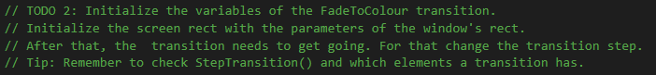
TODO 2
Check the variables of the FadeToColour transition.
The window parameters should be taken into account.
Remember that the step variable exists :)

Slide 67
TODO 3
There is a function that return the cutoff_rate given a step_duration.
The MAX limit value is already defined. Think about where :)

Slide 68
TODO 4
Very similar to the previous TODO.
Check for MIN value insead for MAX value.
Remember what you did in TODO 1.

Slide 69
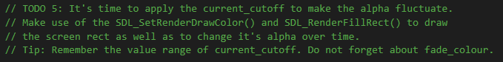
TODO 5
Check SDL_SetRenderDrawColor() and SDL_FillRect().
Take into account how current_rate fluctuates.
Remember which is the value range of the alpha :)

Slide 70
TODO 6A
Check the variables that FadeToColour receives.

Slide 71
TODO 6B
The method should check if a transition is already executing.
The new transition must be assigned to a variable. Think about which one :)
The method should somehow notify that a transition has been loaded.

Slide 72
TODO 7A
Just call the Create method you coded in the previous TODOs :)
Take into account to which scene do you want to go.

Slide 73
TODO 7B
Almost the same as the previous TODO.
Again, take into account to which scene do you want to go.
Experiment with the parameters of the method :)
Press 2 to see whether or not the transition was correctly implemented.

Slide 74

TODO 2~7B Intended Result

Slide 75
TODO 8
Make sure you understand what Lerp() and N_Lerp() do.
Once you understand the methods, just pass the correct parameters :)

Slide 76

TODO 8 Intended Result

Slide 77
TODO 9A
The screen rect should go from one edge to the other and return.
Just apply what you have learned about Lerp() and N_Lerp() :)
Again, remember how current_cutoff fluctuates.

Slide 78
TODO 9B
Very similar to the previous TODO, but the transition is vertical.
Think about which screen parameter needs to be modified.
Remember to pass the correct parameters to Lerp() or N_Lerp().

Slide 79

TODO 9 Intended Result

Slide 80
TODO 10A
The screen rect should cross the screen from one side to the other.
Again, the window parameters should be taken into account.
This time, current_cutoff fluctuates differently, check out how :)
Notice how the method is broken down in different steps. Think about why :)

Slide 81
TODO 10B
Again, very similar to the previous TODO, but vertical.
It’s your turn to code the step breakdown now :)

Slide 82

TODO 10 Intended Result

Slide 83
Think about how to adapt this system to your project

Slide 84
Thank you for your attention!
Mail: angotov@gmail.com
GitHub: BarcinoLechiguino

